Slide 1
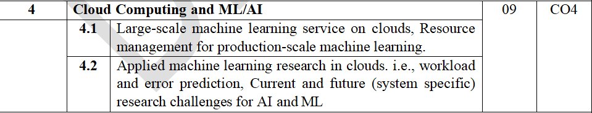
Module 4: Cloud Computing and ML/AI

Slide 2
Applied machine learning research in Cloud: workload and error prediction
Applied machine learning in cloud computing means using ML models to learn patterns from historical cloud data and then use those patterns to predict future workload, resource requirements, failures, errors, or performance problems.
Cloud environments are highly dynamic: user requests, CPU utilization, memory usage, network traffic, VM/container demand, and failures can change rapidly. Recent research emphasizes ML-based predictive resource management rather than relying only on reactive rules.

Slide 3
Applied machine learning research in Cloud: workload and error prediction
1. Workload Prediction
Workload prediction is the process of predicting the amount of computing work that will arrive in the future.
For example:
A cloud server currently receives 1,000 requests/minute.
Historical data shows that traffic normally rises to 5,000 requests/minute between 10 AM and 11 AM.
An ML model predicts that the workload will reach 4,800 requests/minute in the next 15 minutes.
The cloud system can then allocate additional resources before the workload increases.

Slide 4
Applied machine learning research in Cloud: workload and error prediction
1. Workload Prediction
What can be predicted?
ML models can predict:
Number of user requests
CPU utilization
Memory utilization
Network traffic
Number of VM/container instances required
Storage I/O
Response time
Energy consumption
Application workload
Future resource demand
Workload prediction is particularly useful for proactive autoscaling, resource provisioning, QoS management, and energy optimization.

Slide 5
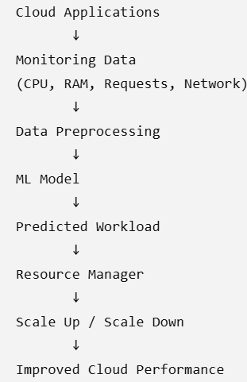
Applied machine learning research in Cloud: workload and error prediction
2. Basic ML-Based Workload Prediction Architecture
The workflow as:
Cloud Monitoring → Data Collection → Data Preprocessing → ML Model → Workload Prediction → Resource Decision → Cloud Infrastructure
For example:
The ML model continuously learns
from historical and recent observations.

Slide 6
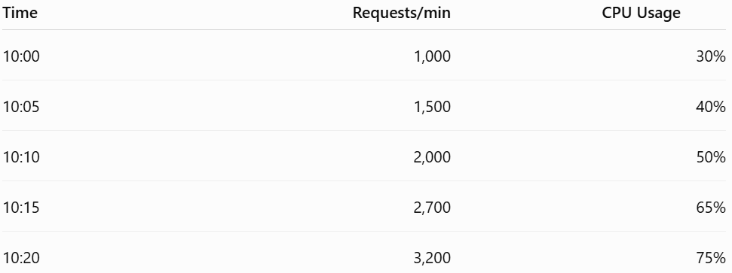
Applied machine learning research in Cloud: workload and error prediction
3. Example of Workload Prediction
Suppose we have the following historical data:
The ML model identifies the relationship between workload and resource usage.

Slide 7
Applied machine learning research in Cloud: workload and error prediction
3. Example of Workload Prediction
It predicts:
10:25 → 3,800 requests/minute → approximately 85% CPU
The cloud management system can therefore start additional VM/container instances before CPU reaches a critical level.
This is called predictive autoscaling.
Recent research specifically identifies workload prediction as an important mechanism for determining how many containers or other resources should be provisioned.

Slide 8
Applied machine learning research in Cloud: workload and error prediction
4. ML Algorithms Used for Workload Prediction
Different ML approaches can be used.
A. Regression
Used when the output is a numerical value.
Examples:
Linear Regression
Polynomial Regression
Support Vector Regression
Input:
CPU, memory, previous requests, time of day
Output:
Predicted requests for the next 10 minutes.

Slide 9
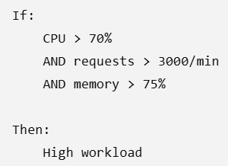
Applied machine learning research in Cloud: workload and error prediction
4. ML Algorithms Used for Workload Prediction
B. Decision Trees / Random Forest
These can learn nonlinear relationships between different cloud metrics.
Example:
Random Forest and other ensemble methods have been studied for cloud workload/resource prediction.

Slide 10
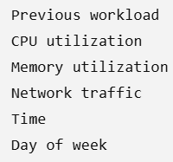
Applied machine learning research in Cloud: workload and error prediction
4. ML Algorithms Used for Workload Prediction
C. Neural Networks
Neural networks are useful when workload behavior is complex.
Inputs may include:
Output:
Predicted workload

Slide 11
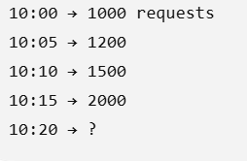
Applied machine learning research in Cloud: workload and error prediction
D. LSTM
Long Short-Term Memory (LSTM) networks are particularly useful for time-series workload data.
For example:
LSTM uses previous observations to predict the next workload.
Recent research continues to investigate deep-learning and hybrid approaches for cloud workload forecasting.

Slide 12
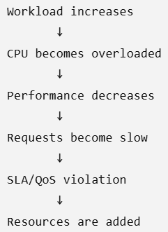
Applied machine learning research in Cloud: workload and error prediction
5. Why Workload Prediction Is Important
Without prediction:
This is reactive resource management.

Slide 13
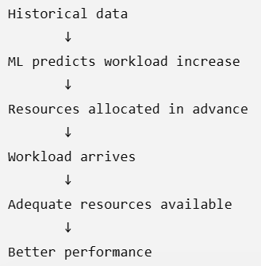
Applied machine learning research in Cloud: workload and error prediction
5. Why Workload Prediction Is Important
With ML:
This is predictive/proactive resource management.
Research surveys describe this as a major motivation for ML-based cloud resource management.

Slide 14
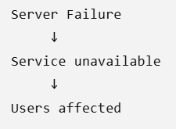
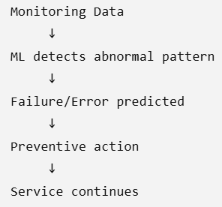
Applied machine learning research in Cloud: workload and error prediction
6. Error Prediction in Cloud Computing
The second important application is error prediction.
Here, ML is used to predict whether a cloud application, VM, container, server, or service is likely to experience an error or failure.
Instead of waiting for:
we want:

Slide 15
Applied machine learning research in Cloud: workload and error prediction
6. Error Prediction in Cloud Computing
Examples of errors that can be predicted
VM failure
Server failure
Container failure
Disk failure
Network failure
Application crashes
Memory errors
CPU overload
SLA violations
Abnormal response time
Service outages

Slide 16
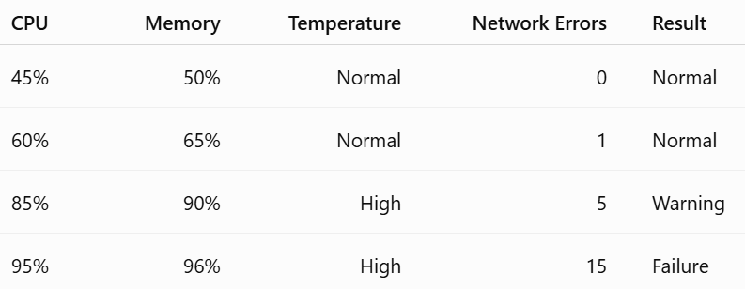
Applied machine learning research in Cloud: workload and error prediction
7. Data Used for Error Prediction
The ML model can learn from historical monitoring and log data.
For example:
The ML model learns patterns associated with failures.
For example:
High CPU + high memory + increasing network errors → high probability of failure.

Slide 17
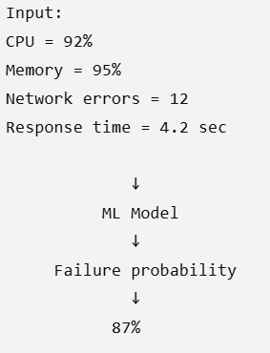
Applied machine learning research in Cloud: workload and error prediction
8. Classification for Error Prediction
Error prediction can be treated as a classification problem.
For example:
The system can classify the situation as:
NORMAL
WARNING
CRITICAL

Slide 18
Applied machine learning research in Cloud: workload and error prediction
8. Classification for Error Prediction
Algorithms can include:
Logistic Regression
Decision Tree
Random Forest
SVM
Neural Networks
Gradient Boosting
Deep Learning

Slide 19
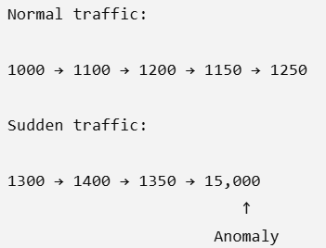
Applied machine learning research in Cloud: workload and error prediction
9. Anomaly Detection
Another important research area is anomaly prediction/detection.
An anomaly is behavior that is significantly different from normal behavior.
For example:
An ML system can detect this unusual pattern and generate an alert.

Slide 20
Applied machine learning research in Cloud: workload and error prediction
9. Anomaly Detection
This is useful for:
Detecting abnormal applications
Identifying resource exhaustion
Detecting unusual network behavior
Detecting service degradation
Predicting failures

Slide 21
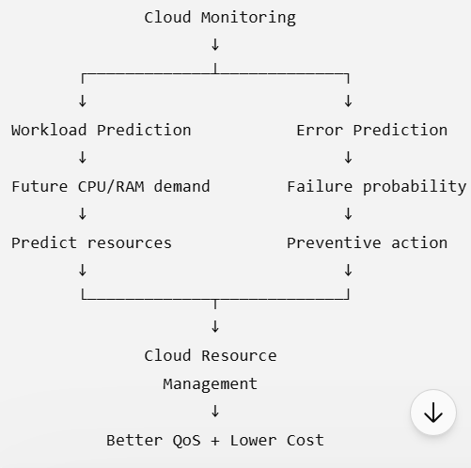
Applied machine learning research in Cloud: workload and error prediction
10. Workload Prediction + Error Prediction
These two research areas can also be combined.
This creates an intelligent predictive cloud management system.

Slide 22
Applied machine learning research in Cloud: workload and error prediction
11. Example Research Problem
A good research problem could be:
"Machine Learning-Based Workload and Failure Prediction for Proactive Cloud Resource Management."
The objective would be:
Collect cloud monitoring data.
Preprocess the historical data.
Train an ML model for workload prediction.
Predict future CPU/memory/request demand.
Train another model for error/failure prediction.
Integrate predictions with autoscaling.
Compare the ML-based approach with traditional threshold-based scaling.
Measure performance.

Slide 23
Applied machine learning research in Cloud: workload and error prediction
11. Example Research Problem
Possible evaluation metrics
For workload prediction:
MAE
MSE
RMSE
MAPE
R²
For error/failure prediction:
Accuracy
Precision
Recall
F1-score
ROC-AUC
False-positive rate
False-negative rate

Slide 24
Applied machine learning research in Cloud: workload and error prediction
12. Key Research Challenges
Some important research challenges are:
1. Highly dynamic workload
Cloud workloads can change suddenly, making prediction difficult.
2. Data heterogeneity
Data may come from:
VMs
Containers
Applications
Networks
Storage
ServersFalse-negative rate

Slide 25
Applied machine learning research in Cloud: workload and error prediction
12. Key Research Challenges
3. Prediction accuracy
An incorrect prediction can cause either resource wastage or performance degradation.
4. Prediction latency
The prediction itself must be fast enough to support real-time resource management.
5. Concept drift
Cloud workload patterns can change over time, so an ML model trained on old data may become less accurate.
6. Cost of ML
Training and running complex ML models consumes computational resources itself.

Slide 26
Applied machine learning research in Cloud: workload and error prediction
12. Key Research Challenges
7. Explainability
Cloud administrators may need to understand why the ML model predicted a failure or requested additional resources.
These issues are among the broader challenges identified in ML-centric cloud resource-management research.

Slide 27
Current and future (System specific) challenges for AI and ML
AI/ML in cloud computing brings together machine learning algorithms, large-scale data, distributed computing, GPUs/accelerators, networking, storage, and cloud management. As AI models become larger and are used by more users, several system-level challenges arise.
A useful way to organize the challenges is:
Data → Compute → Memory → Network → Storage → Scheduling → Reliability → Security → Cost → Sustainability

Slide 28
Current and future (System specific) challenges for AI and ML
1. Compute and Accelerator Management
AI/ML workloads require enormous computational power, especially for deep learning.
Current challenges:
Efficient utilization of GPUs, TPUs and AI accelerators
GPU resources can remain idle while waiting for data.
Different workloads require different GPU capacities.
GPU sharing among multiple users is difficult.
Large models may require multiple GPUs across several servers.
Example:
Training a large neural network may require 8, 16, or hundreds of GPUs. If one GPU becomes unavailable, the entire distributed training job may slow down.

Slide 29
Current and future (System specific) challenges for AI and ML
1. Compute and Accelerator Management
Future challenges
Managing heterogeneous accelerators such as GPU, TPU, NPU and specialized AI chips
Automatic selection of the best accelerator for a workload
Dynamic allocation of accelerators
Efficient sharing of expensive accelerators
Research direction:
Intelligent AI-based GPU/accelerator scheduling and resource allocation.

Slide 30
Current and future (System specific) challenges for AI and ML
2. Memory and Model Size
Modern AI models are becoming extremely large.
For example:
Model → Parameters → GPU Memory → Distributed Memory
Current challenges
Large models may not fit into the memory of a single GPU.
Training requires storing:
model parameters
gradients
optimizer states
intermediate activations
Moving data between CPU and GPU memory introduces overhead.

Slide 31
Current and future (System specific) challenges for AI and ML
2. Memory and Model Size
Future challenges
Models may become so large that they require:
distributed memory
memory pooling
near-memory computing
new memory architectures
intelligent model partitioning
Research direction:
Memory-aware model placement and distributed AI memory management.

Slide 32
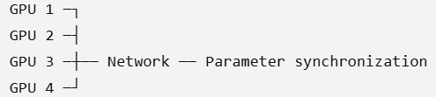
Current and future (System specific) challenges for AI and ML
3. Data Movement and Network Bottlenecks
In distributed ML, computation may occur on many machines.
For example:
Large amounts of data must move between machines.
Current challenges:
Network bandwidth limitations
High communication latency
Parameter synchronization overhead
Data transfer between regions
Congestion during distributed training

Slide 33
Current and future (System specific) challenges for AI and ML
3. Data Movement and Network Bottlenecks
Future challenges
As models become larger, communication may become as important as computation.
Future systems may require:
high-speed interconnects
RDMA
optical networking
intelligent communication scheduling
computation closer to the data

Slide 34
Current and future (System specific) challenges for AI and ML
4. Distributed AI/ML Training
Large models are increasingly trained across many machines.
Current challenges
Distributed training introduces:
synchronization overhead
straggler machines
node failures
network failures
load imbalance
checkpointing overhead

Slide 35
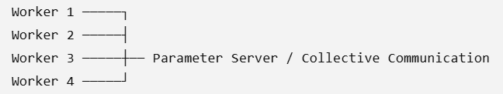
Current and future (System specific) challenges for AI and ML
4. Distributed AI/ML Training
Consider:
If Worker 4 is slow, other workers may have to wait.
Future challenge
Cloud systems must automatically identify:
Which worker is slow, why is it slow, and how should the workload be redistributed?
This creates opportunities for AI-driven workload prediction and resource management.

Slide 36
Current and future (System specific) challenges for AI and ML
5. Resource Scheduling
Cloud providers must decide:
Which ML workload should run on which machine, GPU, memory and network?
Current challenges:
CPU/GPU scheduling
Multi-tenant resource allocation
GPU fragmentation
Priority management
Resource contention

Slide 37
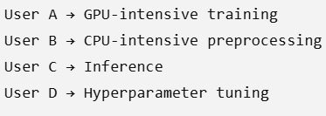
Current and future (System specific) challenges for AI and ML
5. Resource Scheduling
For example:
All compete for cloud resources.
Future challenges Schedulers will need to consider:
workload characteristics
predicted resource demand
deadlines
cost
energy consumption
SLA requirements
model performance
Research Area: Predictive AI/ML resource scheduling for cloud workloads
This connects directly with workload prediction and error/failure prediction.

Slide 38
Current and future (System specific) challenges for AI and ML
6. Cost Optimization
AI workloads can be extremely expensive because GPUs and high-performance infrastructure cost much more than ordinary compute resources.
Current challenges
GPU cost
Data-transfer cost
Storage cost
Idle resources
Over-provisioning
Long training times

Slide 39
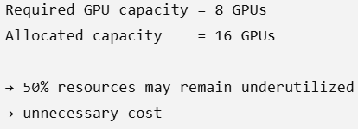
Current and future (System specific) challenges for AI and ML
6. Cost Optimization
A simple situation:
Future challenge
Cloud platforms need cost-aware AI scheduling.
The system could predict:
"This workload will require approximately 6 GPUs for the next 4 hours."
and dynamically allocate resources.

Slide 40
Current and future (System specific) challenges for AI and ML
7. Energy Consumption and Sustainability
AI/ML infrastructure consumes substantial electricity.
Current challenges
GPU power consumption
Data-center cooling
Large-scale model training
Continuous inference workloads
AI systems therefore have both:
Computational cost + Energy cost

Slide 41
Current and future (System specific) challenges for AI and ML
7. Energy Consumption and Sustainability
Future challenges
Cloud AI systems may need to optimize:
energy consumption
carbon emissions
cooling requirements
workload placement
renewable-energy availability

Slide 42
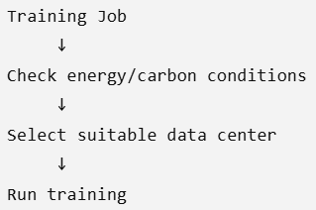
Current and future (System specific) challenges for AI and ML
7. Energy Consumption and Sustainability
For Example:
Research direction:
Carbon-aware and energy-aware AI workload scheduling.

Slide 43

Current and future (System specific) challenges for AI and ML
8. Data Storage and Data Access
ML systems process enormous datasets.
Current challenges
Massive data volume
High-speed data access
Dataset duplication
Data preprocessing bottlenecks
Storage-performance mismatch
Sometimes the GPU is ready to compute, but data is not available quickly enough.

Slide 44
Current and future (System specific) challenges for AI and ML
8. Data Storage and Data Access
Future challenges
AI systems will require:
intelligent data caching
distributed storage
high-performance object storage
automated data placement
data locality optimization

Slide 45
Current and future (System specific) challenges for AI and ML
9. Fault Tolerance and Reliability
Large distributed AI systems contain hundreds or thousands of components.
Therefore, failures are inevitable.
Current failures
GPU failure
server failure
network failure
storage failure
software failure
container failure
memory errors

Slide 46
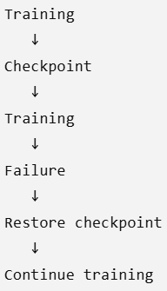
Current and future (System specific) challenges for AI and ML
9. Fault Tolerance and Reliability
Current solution
Checkpointing

Slide 47
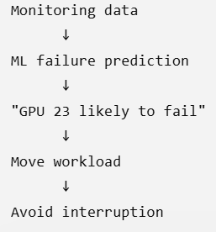
Current and future (System specific) challenges for AI and ML
9. Fault Tolerance and Reliability
Future challenge
Checkpointing itself can become expensive.
Future systems should predict failures before they occur.
For example:
This is an important AI-for-cloud research area.

Slide 48
Current and future (System specific) challenges for AI and ML
10. AI/ML Workload Prediction
Cloud workloads are highly dynamic.
Demand may change rapidly.
Low demand → Medium demand → Peak demand → Low demand
Current challenge
Traditional autoscaling often reacts after resource demand changes.
Future approach
Use ML to predict workload demand.

Slide 49
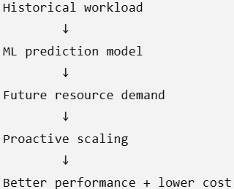
Current and future (System specific) challenges for AI and ML
10. AI/ML Workload Prediction
Future approach
Use ML to predict workload demand.
Possible predictions include:
CPU utilization
GPU utilization
memory usage
network traffic
request rate
execution time
workload failures

Slide 50
Current and future (System specific) challenges for AI and ML
11. Inference Latency
Training is only one part of AI.
Cloud systems increasingly provide real-time inference.
Examples:
chatbots
recommendation systems
fraud detection
autonomous systems
computer vision

Slide 51
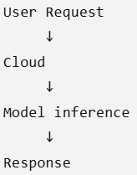
Current and future (System specific) challenges for AI and ML
11. Inference Latency
Current challenge
Users expect very low latency.
Large models can increase inference latency.

Slide 52
Current and future (System specific) challenges for AI and ML
11. Inference Latency
Future challenge
Systems must optimize:
model placementGPU allocation
batching
caching
model compression
edge-cloud cooperation

Slide 53
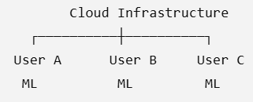
Current and future (System specific) challenges for AI and ML
12. Multi-Tenancy and Resource Contention
Cloud infrastructure is shared by many users.
Current challenges
GPU contention
CPU contention
memory contention
network contention
noisy-neighbor effects
One workload can negatively affect another workload.

Slide 54
Current and future (System specific) challenges for AI and ML
12. Multi-Tenancy and Resource Contention
Future challenge
Cloud systems need isolation-aware AI scheduling that guarantees predictable performance.

Slide 55
Current and future (System specific) challenges for AI and ML
13. Security and Privacy
AI systems process large amounts of potentially sensitive data.
Current challenges
Data leakage
Model theft
Unauthorized access
Adversarial attacks
Poisoned training data
Inference attacks

Slide 56
Current and future (System specific) challenges for AI and ML
13. Security and Privacy
Future challenges
AI systems will require stronger:
confidential computing
privacy-preserving ML
federated learning
secure model serving
AI-specific access control

Slide 57
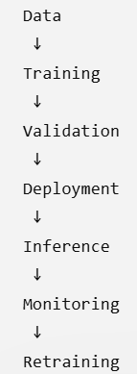
Current and future (System specific) challenges for AI and ML
14. Model Deployment and Lifecycle Management
Training a model is not the end.
A model goes through:

Slide 58
Current and future (System specific) challenges for AI and ML
14. Model Deployment and Lifecycle Management
Current challenges
Version management
Model deployment
Dependency management
Model rollback
Monitoring model performance
Detecting model drift
Future challenge
Cloud platforms should automatically manage the complete ML lifecycle.

Slide 59
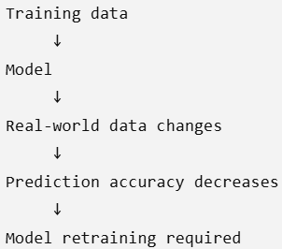
Current and future (System specific) challenges for AI and ML
15. Model Drift and Continuous Learning
Real-world data changes over time.
For example:

Slide 60
Current and future (System specific) challenges for AI and ML
15. Model Drift and Continuous Learning
Future system challenge
Cloud infrastructure must automatically detect:
data drift
concept drift
accuracy degradation
and trigger:
retraining → validation → deployment
automatically.

Slide 61
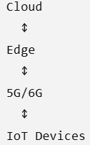
Current and future (System specific) challenges for AI and ML
16. Heterogeneous Cloud and Edge AI
Future AI workloads will not run only in centralized cloud data centers.
They may run across:

Slide 62
Current and future (System specific) challenges for AI and ML
16. Heterogeneous Cloud and Edge AI
Challenges
Deciding where to execute the model
Network latency
Limited edge resources
Synchronization
Privacy
Dynamic workload placement
Future research question:
Should this inference request run on the edge, fog, or cloud?

Slide 63
Current and future (System specific) challenges for AI and ML
17. Serverless AI/ML
Serverless computing is attractive because resources can be allocated automatically.
However, AI workloads have special requirements.
Challenges
GPU support
Cold-start latency
Large model loading
Memory requirements
Long-running training jobs
Model initialization overhead
Future serverless platforms may need AI-aware resource provisioning.

Slide 64
Current and future (System specific) challenges for AI and ML
18. Future AI-Specific Hardware
AI workloads are driving development of specialized hardware.
Examples include:
GPUs
TPUs
NPUs
AI accelerators
FPGA-based accelerators
The challenge is:
How should a cloud scheduler select the best hardware for each ML workload?

Slide 65
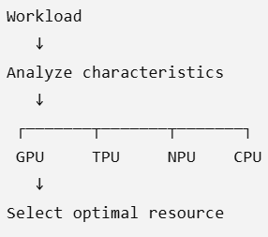
Current and future (System specific) challenges for AI and ML
18. Future AI-Specific Hardware
For Example:

Slide 66
Current and future (System specific) challenges for AI and ML
19. Explainability and System-Level Decision Making
Future cloud platforms themselves may use AI to make decisions.
For example:
"Move this workload from Server A to Server B."
The system should ideally explain:
Why was the workload moved?
Why was a particular GPU selected?
Why was scaling triggered?
Why was a job terminated?
This becomes important for trustworthy autonomous cloud management.

Slide 67
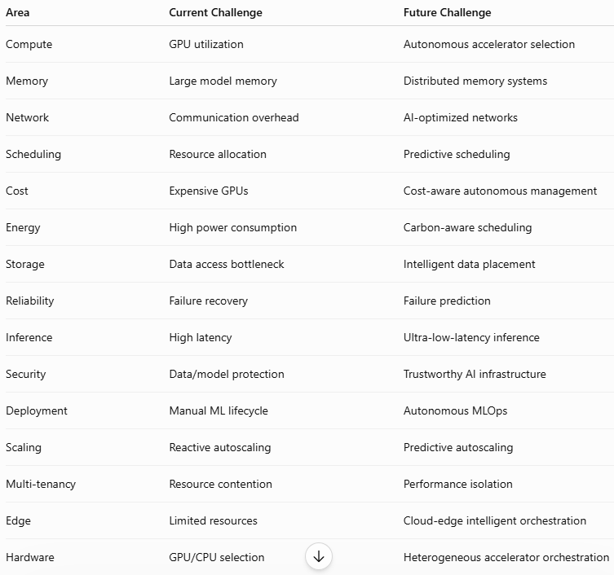
Current and future (System specific) challenges for AI and ML

